Slide 1

Peer‐Learning Project CUSA-Microvan Case
Barres Group
ESMT Global Online MBA

Slide 2

Introduction
In this group project, we will be revisiting the Microvan case, which we have already started exploring. The objective is to build upon the previous exploratory analysis using analytical tools and methods discussed in the course.

Slide 3
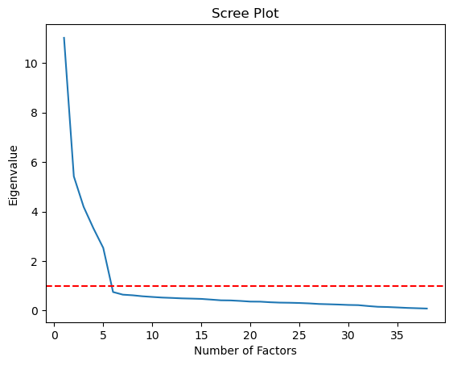
Analytical Steps
Exploring Redundancy: We will begin by examining the degree of redundancy in the 30 attribute variables that were previously analyzed. This will be done using factor analysis to determine if improvements can be made in explaining the concept liking variable. Using Python, we performed factor analysis on the data to obtain eigenvalues. The scree plot indicated that 6 factors were optimal. Also, the cumulative variance explained for 6 factors was 70.85%.

Slide 4
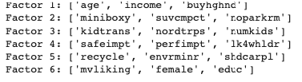
Analytical Steps
Naming Factors: Key Variables with Highest Loadings for Each Factor:
Factor 1: "Family-oriented Preferences" Variables: kidtrans, miniboxy, buyhghnd This factor seems to capture preferences related to family transportation, including the need for a car to transport kids and their friends, a preference for less boxy and large minivans, and a tendency to buy higher-end cars.
Factor 2: "Parking and Compactness Preferences" Variables: noparkrm, suvcmpct, miniboxy This factor reflects preferences related to parking space availability and compactness, indicating a preference for cars suitable for limited parking space and a preference for more compact SUVs over larger minivans.
Factor 3: "Travel and Family Size Preferences" Variables: kidtrans, nordtrps, numkids This factor captures preferences related to travel and family size, including the need for a car to transport kids, a lack of road trips with the family, and consideration of the number of children in the household.
Factor 4: "Safety and Performance Preferences" Variables: safeimpt, perfimpt, lk4whldr This factor represents preferences related to safety and performance, indicating a high importance placed on auto safety, performance, and an attraction to four-wheel drive options.
Factor 5: "Environmental and Sustainable Preferences" Variables: recycle, envrminr, shdcarpl This factor reflects preferences related to environmental and sustainable practices, including a strong belief in recycling, perceiving the environmental impact of automobiles as relatively minor, and endorsing carpooling and public transportation.
Factor 6: "Liking, Gender, and Education" Variables: mvliking, female, educ This factor captures respondents' self-reported liking of cars, their gender, and their education level.

Slide 5
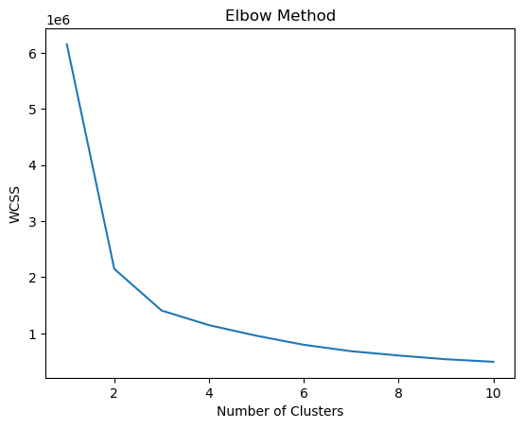
Analytical Steps
Market Segmentation:
Next, we conducted cluster analysis based on the factor scores obtained from the previous step. The aim is to segment the market and gain insights into the clustering solution's meaning and interpretation. By employing the Elbow Method, we determined that 3 clusters would be suitable for segmentation.

Slide 6
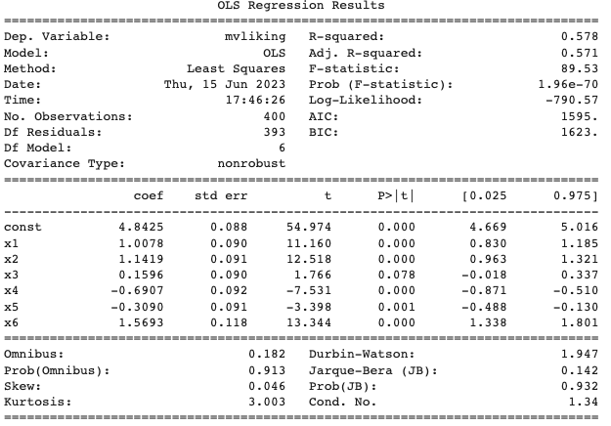
Analytical Steps
Regression Analysis/Relating Clusters to Demographics:
Factor1: An increase in Factor1 is associated with an average increase in mvliking score of 1.0078.
Factor2: An increase in Factor2 is associated with an average increase in mvliking score of 1.1419.
Factor3: Factor3 has a relatively weaker impact on mvliking, with an average increase in mvliking score of 0.1596 (marginally significant).
Factor4: An increase in Factor4 is associated with an average decrease in mvliking score of 0.6907.
Factor5: An increase in Factor5 is associated with an average decrease in mvliking score of 0.3090.
Factor6: An increase in Factor6 is associated with an average increase in mvliking score of 1.5693.
These findings suggest that Factors 1, 2, and 6 have a positive impact on mvliking, while Factors 4 and 5 have a negative impact. Factor3 has a relatively weaker effect. Overall, these factors collectively explain approximately 57.8% of the variance in mvliking scores, indicating a moderate level of influence.

Slide 7

Analytical Steps
Cluster Analysis:
We performed cluster analysis based on the factor scores and identified the following interpretations:
Cluster 0: This cluster exhibits a high negative loading on Factor 1, indicating a strong presence of preferences related to "Family-oriented Preferences." Individuals in this cluster prioritize family transportation, buying higher-end cars, and preferring less boxy and large minivans.
Cluster 1: This cluster has a high positive loading on Factor 2, suggesting a significant presence of preferences related to "Parking and Compactness Preferences." Individuals in this cluster prioritize cars suitable for limited parking space and show a preference for more compact SUVs over larger minivans.
Cluster 2: This cluster shows relatively high positive loadings on both Factor 2 and Factor 3. It indicates the coexistence of preferences related to "Parking and Compactness Preferences" as well as "Travel and Family Size Preferences." Individuals in this cluster consider factors such as parking space availability, compactness, family transportation, and the number of children in the household.

Slide 8
Conclusions
In conclusion, based on the analysis of the Microvan case, we recommend targeting Cluster 2 as the primary market segment for the microvan concept in the US market. Cluster 2 exhibits preferences related to both "Parking and Compactness Preferences" and "Travel and Family Size Preferences," indicating a potential overlap in the target audience. This segment prioritizes factors such as parking space availability, compactness, family transportation, and consideration of the number of children in the household. By tailoring marketing strategies to meet the needs and preferences of Cluster 2, we can effectively engage this segment and maximize the potential for success in the US market.
*However, further research and validation are recommended to refine the targeting strategy and ensure its alignment with the company's goals and resources.

Slide 9
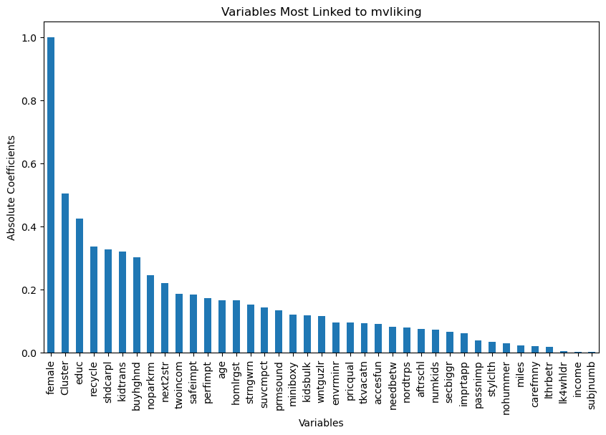
Other Data/Insights
Data Source: The analysis and visualizations in this presentation, made by our group, are based on the Microvan Case dataset, available at https://github.com/MatiasGrob/MicrovanCase/blob/main/MicrovanCase.ipynb

